Slide 1
Bonobo git server

Slide 2
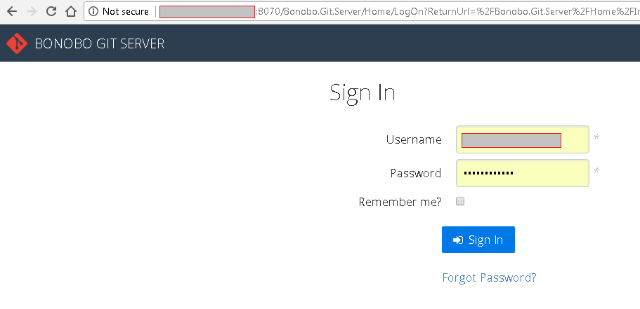
Bonobo git server: http://<domain>:8070/Bonobo.Git.Server/Repository/Index

Slide 3
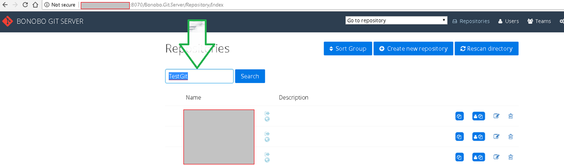
Search for repository

Slide 4
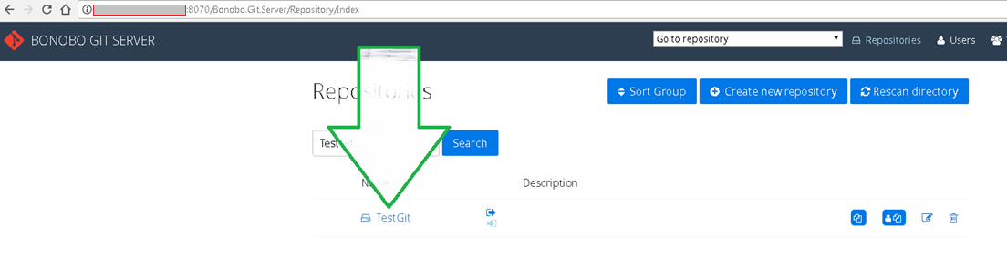
Click on the repo link

Slide 5
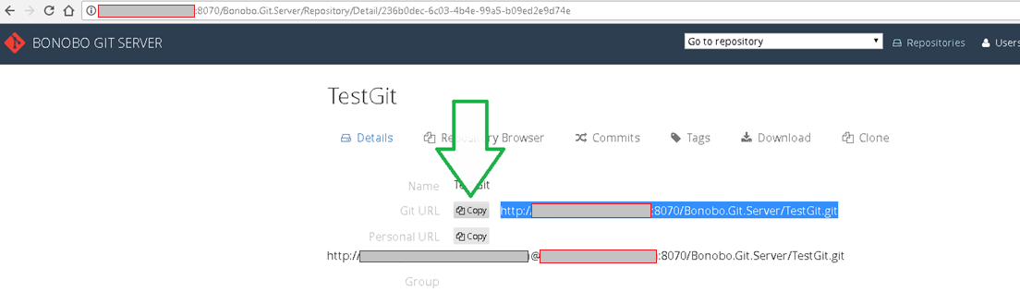
copy the url or click to copy

Slide 6
Git in Eclipse

Slide 7
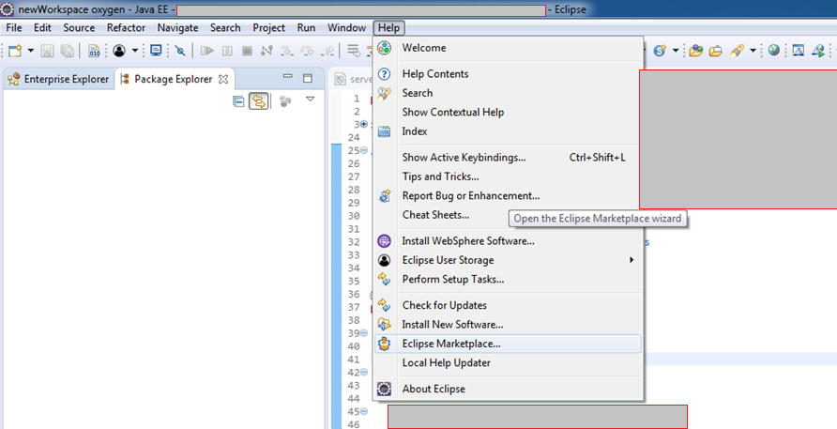
Install Egit from marketplace

Slide 8
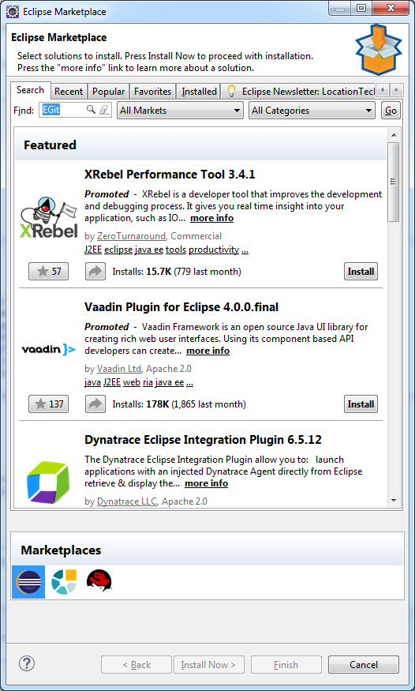
Install Egit from marketplace

Slide 9
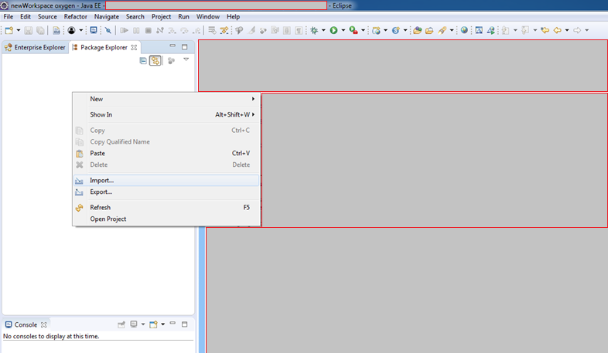
Import project from Git repository

Slide 10
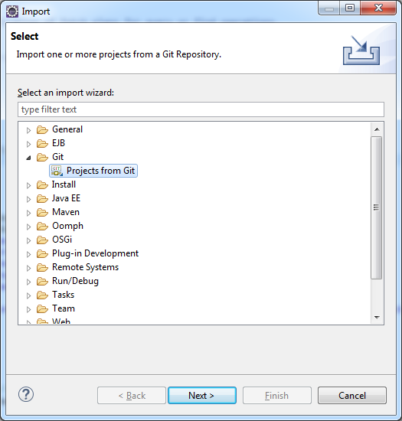

Slide 11
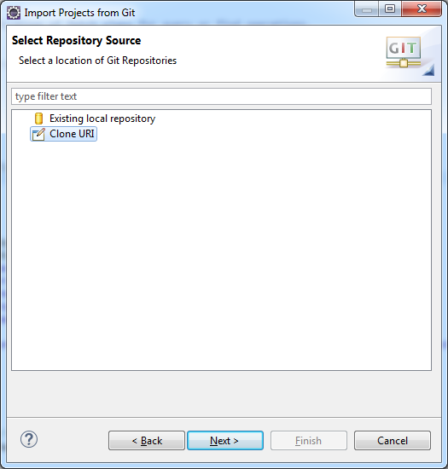

Slide 12
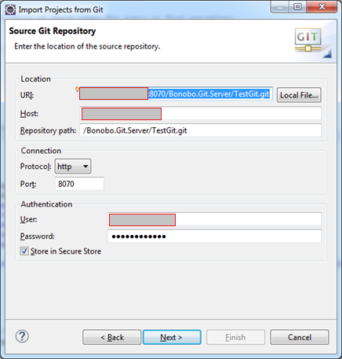
paste the git repo url, rest of the values will autopopulate

Slide 13
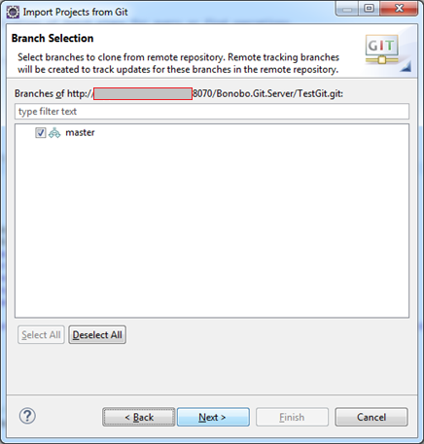
click next

Slide 14
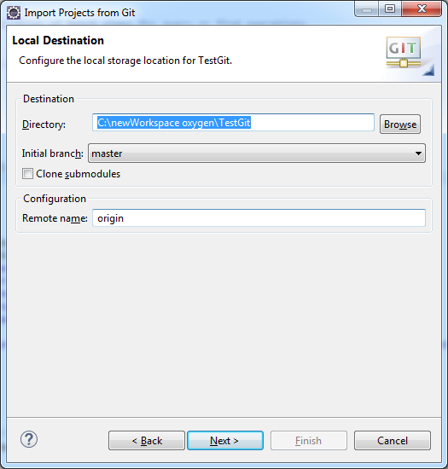
browse and select a directory, project name will be added automatically to the end

Slide 15
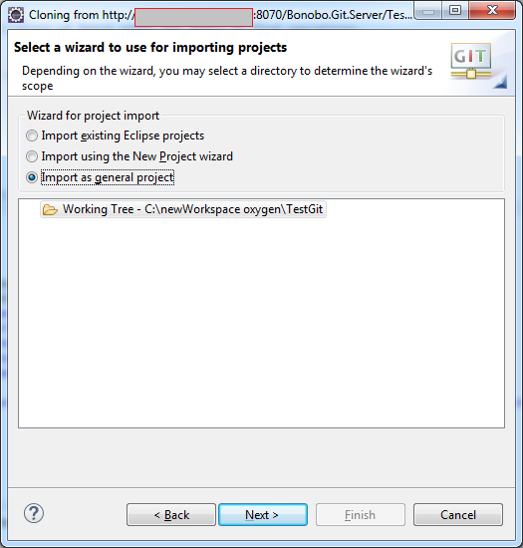

Slide 16
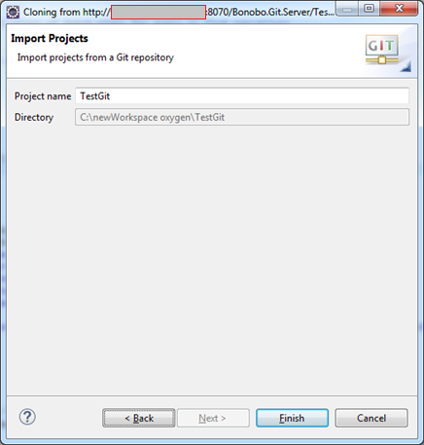
click on finish button

Slide 17
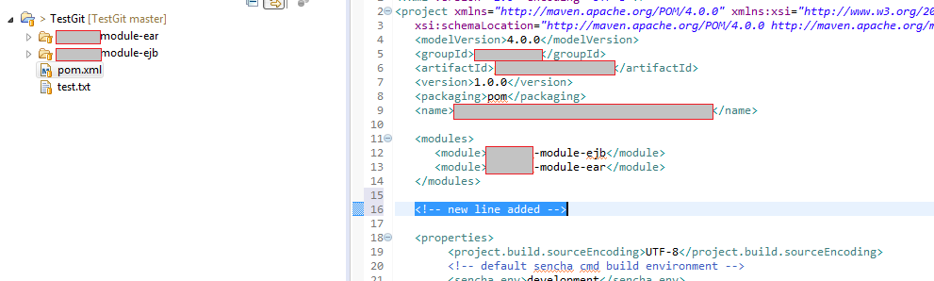
demonstrating Git commit and push

Slide 18
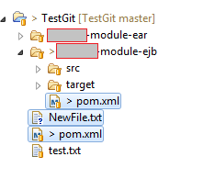
“>” appears in front of modified files “?” appears in front of new files

Slide 19
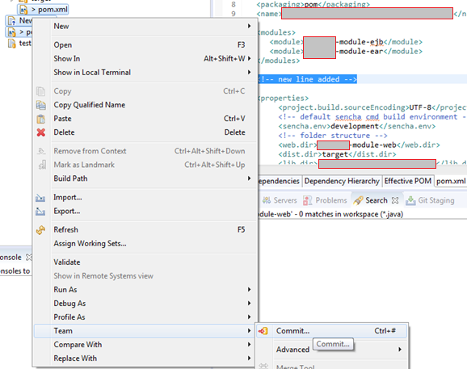
right click on files and select Team -> Commit to open “Git Staging” window

Slide 20
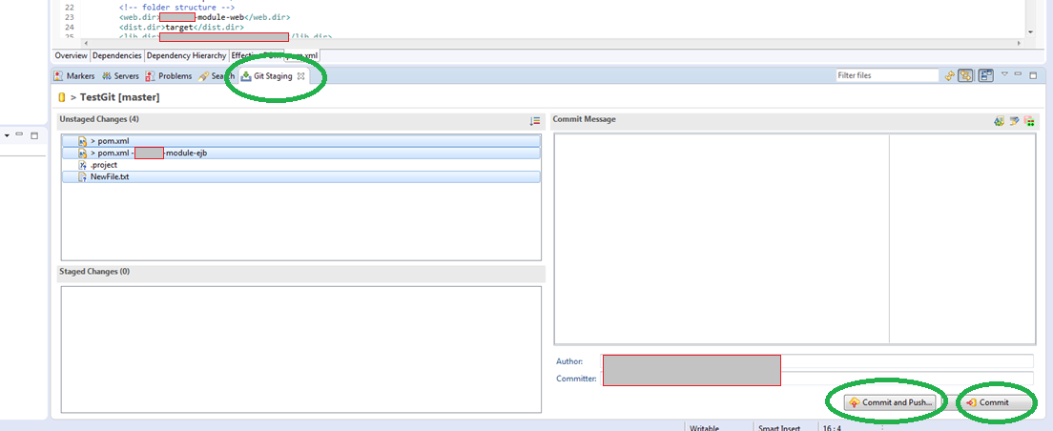
select files to commit or push in this example, I am pushing the changes to remote repo

Slide 21
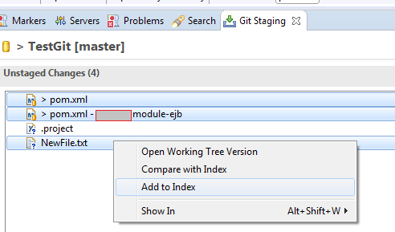
right click on the files and select “Add to Index”

Slide 22
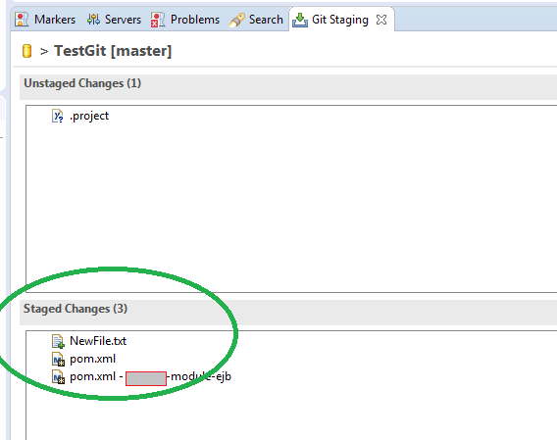
selected files move to “Staged Changes” section

Slide 23
Why do I need to stage? From https://community.atlassian.com/t5/Sourcetree-questions/Staged-vs-Unstaged/qaq-p/127916
The staging area (aka index) is a container where git collects all changes which will be part of the next commit.
If you are editing a versioned file on your local machine, git recognizes that your file is modified - but it will not be automatically part of your next commit and is therfore unstaged. Staging the file will put the file into the staging area (index). The next git commit will transfer all items from staging are into your repository.
What is this good for? Imagine you are in hectic and you have to fix a few bugs in your software. Usually you edit your files and fix simultaneously several bugs. After this you have a lot of unstaged but modified files. On the other hand you want to have "clean" commits: each commit should be defintifly related to a single bug only. Using the staging area you could collect all changes referring to a single bug and make a clean commit - in your next step you stage all changes for the next bug and make the next clean commit ...
You could not only stage complete files - but also "hunks" (parts of a file) and even single lines from a modified file (sourcetree is a great tool for preparing the staging area with great facilities for staging files, hunks or lines).
Editing a versioned file makes the file modified, but unstaged. Staging the file/hunk/line adds the change to the staging area. The changes within the staging area are part of the next commit. The commit transfers all changes from staging area into your repository. The staging area allows you to collect all changes to get a "clean" commit.
See:
https://git-scm.com/book/en/v2/Getting-Started-Git-Basics
http://gitolite.com/uses-of-index.html

Slide 24
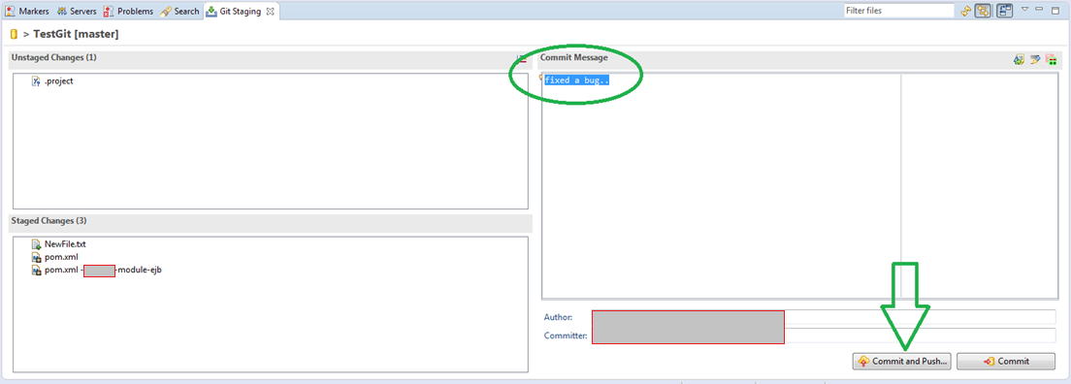
- type in a commit message that describes what you did - click on “Commit and Push” button

Slide 25
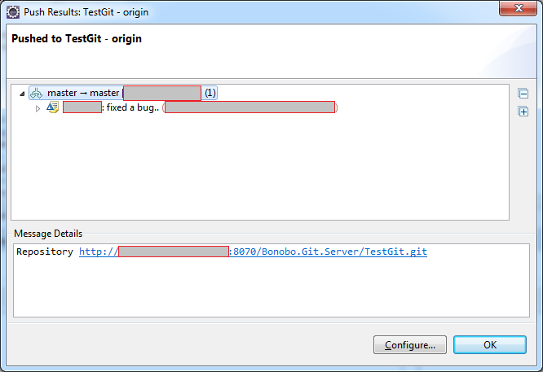
click OK

Slide 26
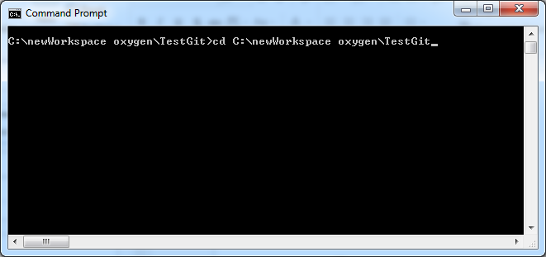
using Command Line
Open command prompt and move to the project directory

Slide 27
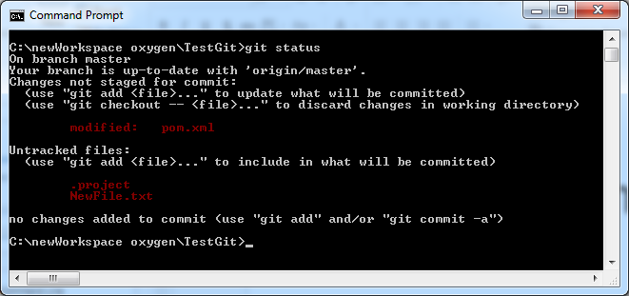
Check for changes - pom.xml is modified - NewFile.txt is added new

Slide 28
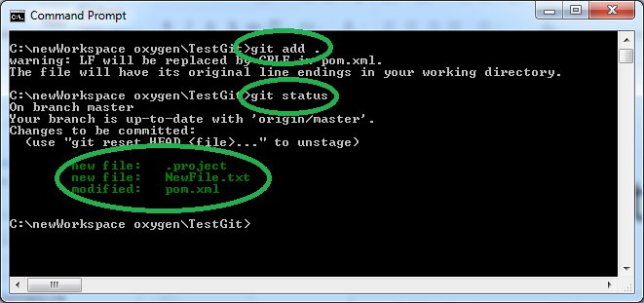
Type “git add .” to stage all changes in one command You can add individual files by providing file paths git add <file path comma separated>

Slide 29
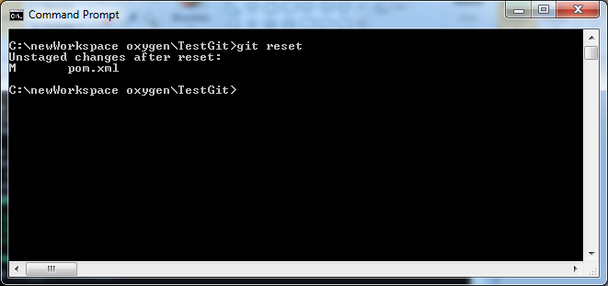
To remove files added to staging area (unstaging) git reset you can reset individual files too by providing file path git reset <file path>

Slide 30
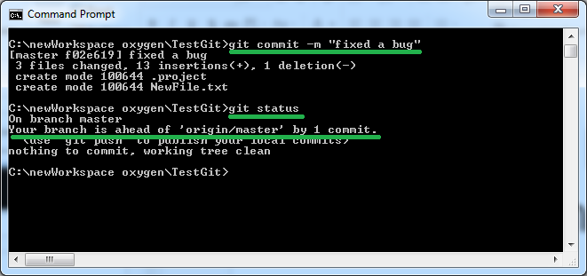
commit changes to local repository git commit –m “<commit message>”

Slide 31
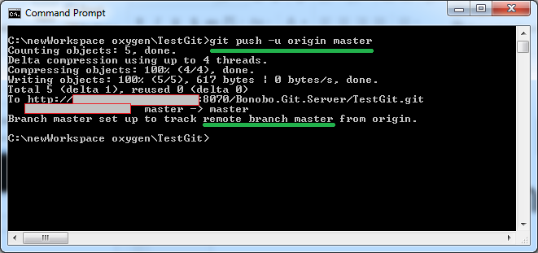
push changes to remote repository

Slide 32
Creating , deleting branch

Slide 33
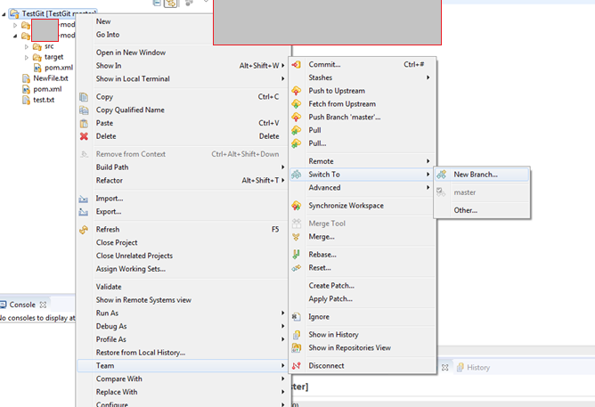
Creating a branch: Right click project -> Team -> Switch To -> New Branch

Slide 34
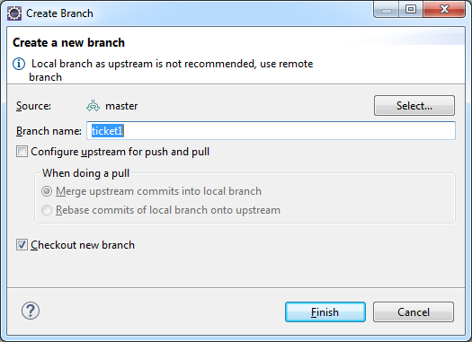
Name the branch

Slide 35
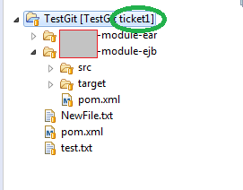
Note the change to branch name

Slide 36
In command line: switch to branch, create new branch
- to switch to an existing remote branch “git checkout –b <remote branch name>” - to create a new local branch “git checkout –b <new branch name>” You will have to switch to a different branch before deleting a branch.

Slide 37
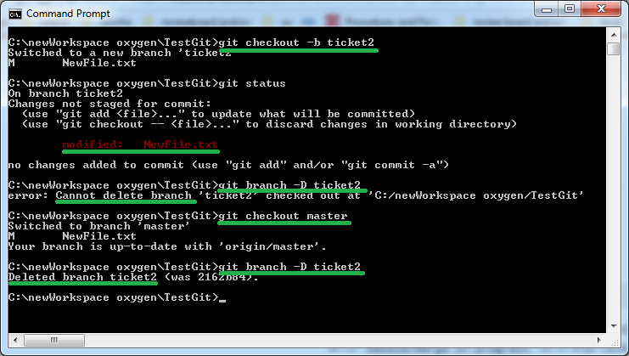
Create and delete local branch commands: git checkout –b <local branch name to create> git branch –D <local branch name to delete>

Slide 38
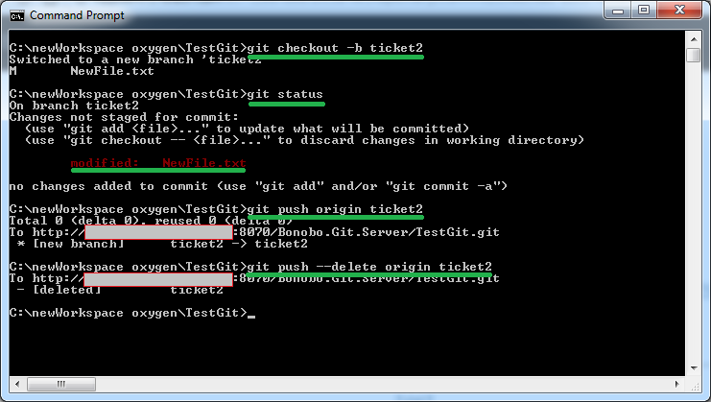
Create and delete remote branch commands: git checkout –b <local branch name to create> git push origin <remote branch name to create> git branch –D origin <remote branch name to delete>

Slide 39
merging branches

Slide 40
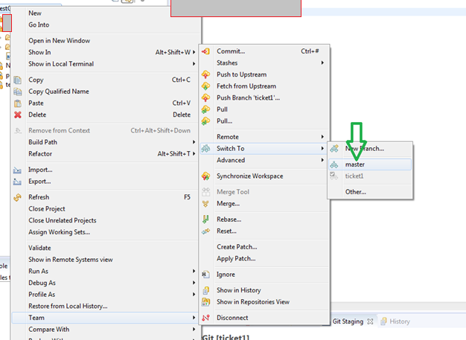
I pushed a change to branch “ticket1” Switch to branch “master” We are going to merge “ticket1” into “master”

Slide 41
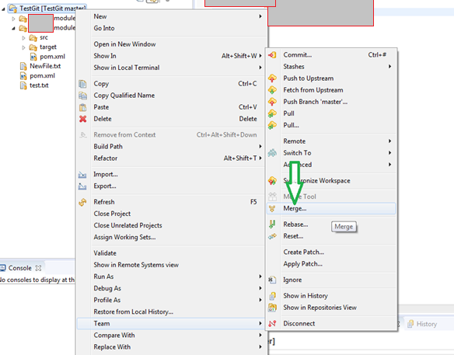
Right click project ->Team ->Merge

Slide 42
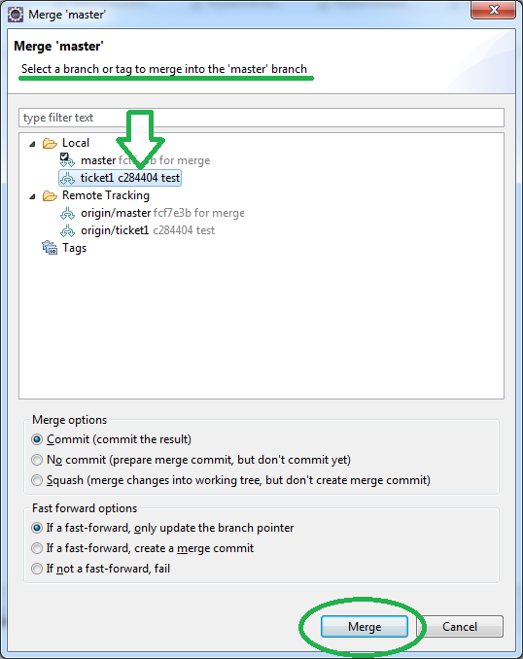
- select local “ticket1” branch if you want to merge local changes - select remote “ticket1” branch if you want to merge remote changes - click on Merge button

Slide 43
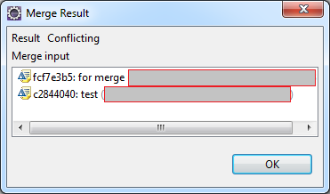
Click OK

Slide 44
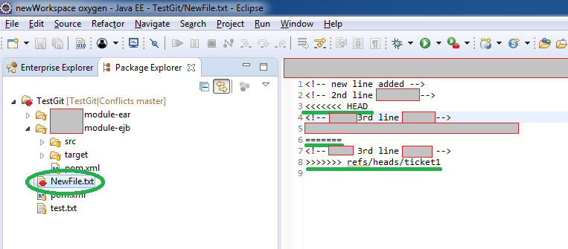
Conflicts appear like this. Resolve conflicts and save the file(s).

Slide 45
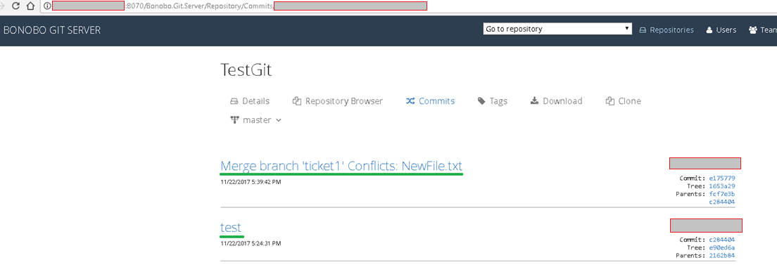
To push merged changes refer slide 19 Git server (bonobo) shows the commit message from branch “ticket1” and another message that merge happened

